Slide 1


Red Blood Cell Abnormality Detection Under Federated Environment Using Deep Learning
CSE707: Distributed Computing Systems
Group Members & ID
Shakib Mahmud Dipto [22166030]
Nadia Tasnim Mim [22366021]
Group-5

Slide 2
Introduction
In medical case scenarios, it is important to keep patient information confidential [1].
The use of federated environments in medical cases can help in increasing the screening process by building powerful models [2].
Deep learning models help us to increase the accuracy of our research [3].
Deep learning models have been used for red blood cell abnormality detection in serious hematological disorders [4].

Slide 3
Introduction
Federated Learning system ensure the privacy of data. [5].
The use of FLA has been proven to be helpful in the detection of possible invasion in MCPS[6].
Federated Learning system has been used in intrusion detection system to provide security [7].
Red blood cell abnormalities can be an early sign of clinical deterioration of health in serious medical cases [8].
Use of deep learning to diagnose blood cells can aid in identifying various blood-related diseases [9].
1

Slide 4
Introduction
In this study, Federated Learning (FL) method was used to classify RBC anomalies from RBC images.
No client information was shared with the FL method.
The best performing Deep Learning (DL) model was selected.
The FL method was trained using the weights from local model.
Comparison of the accuracy rate between the FL model and DL model.
1

Slide 5
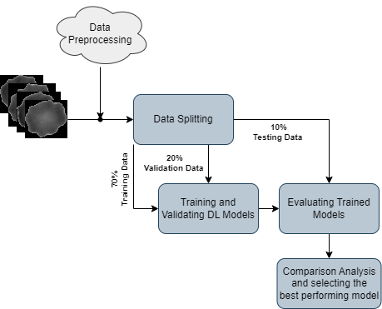
Methodology
(Identification of best performing DL model)

Slide 6
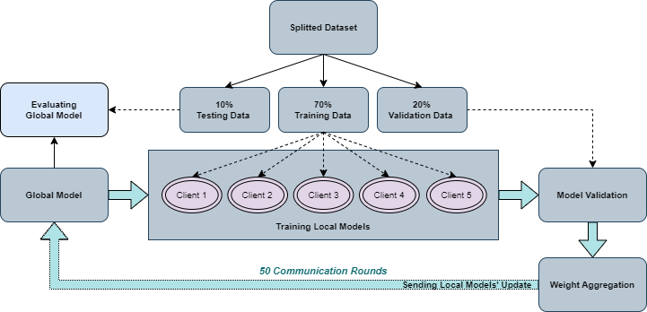
Methodology
(RBC Abnormality Classification Under FL environment)

Slide 7
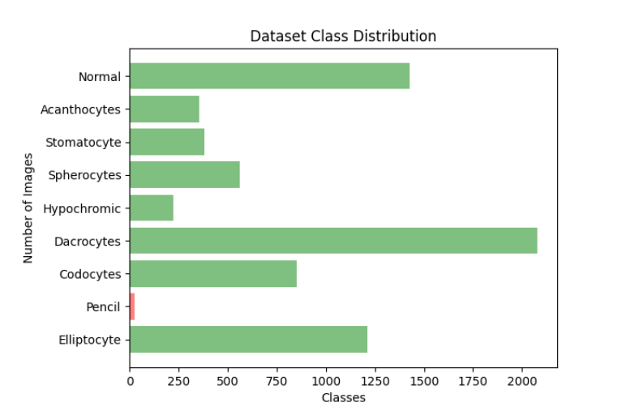
Dataset Description
Datasets : RBCdataset

Slide 8
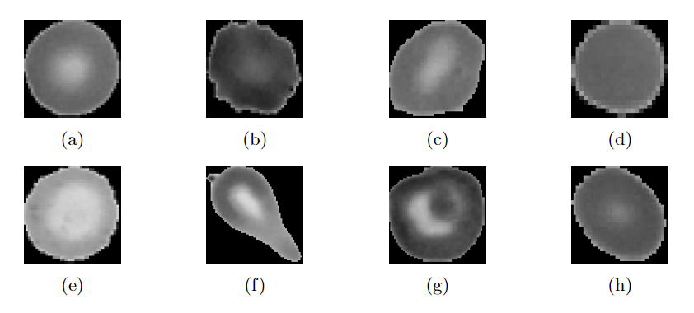
Dataset Description
Datasets : RBCdataset

Slide 9
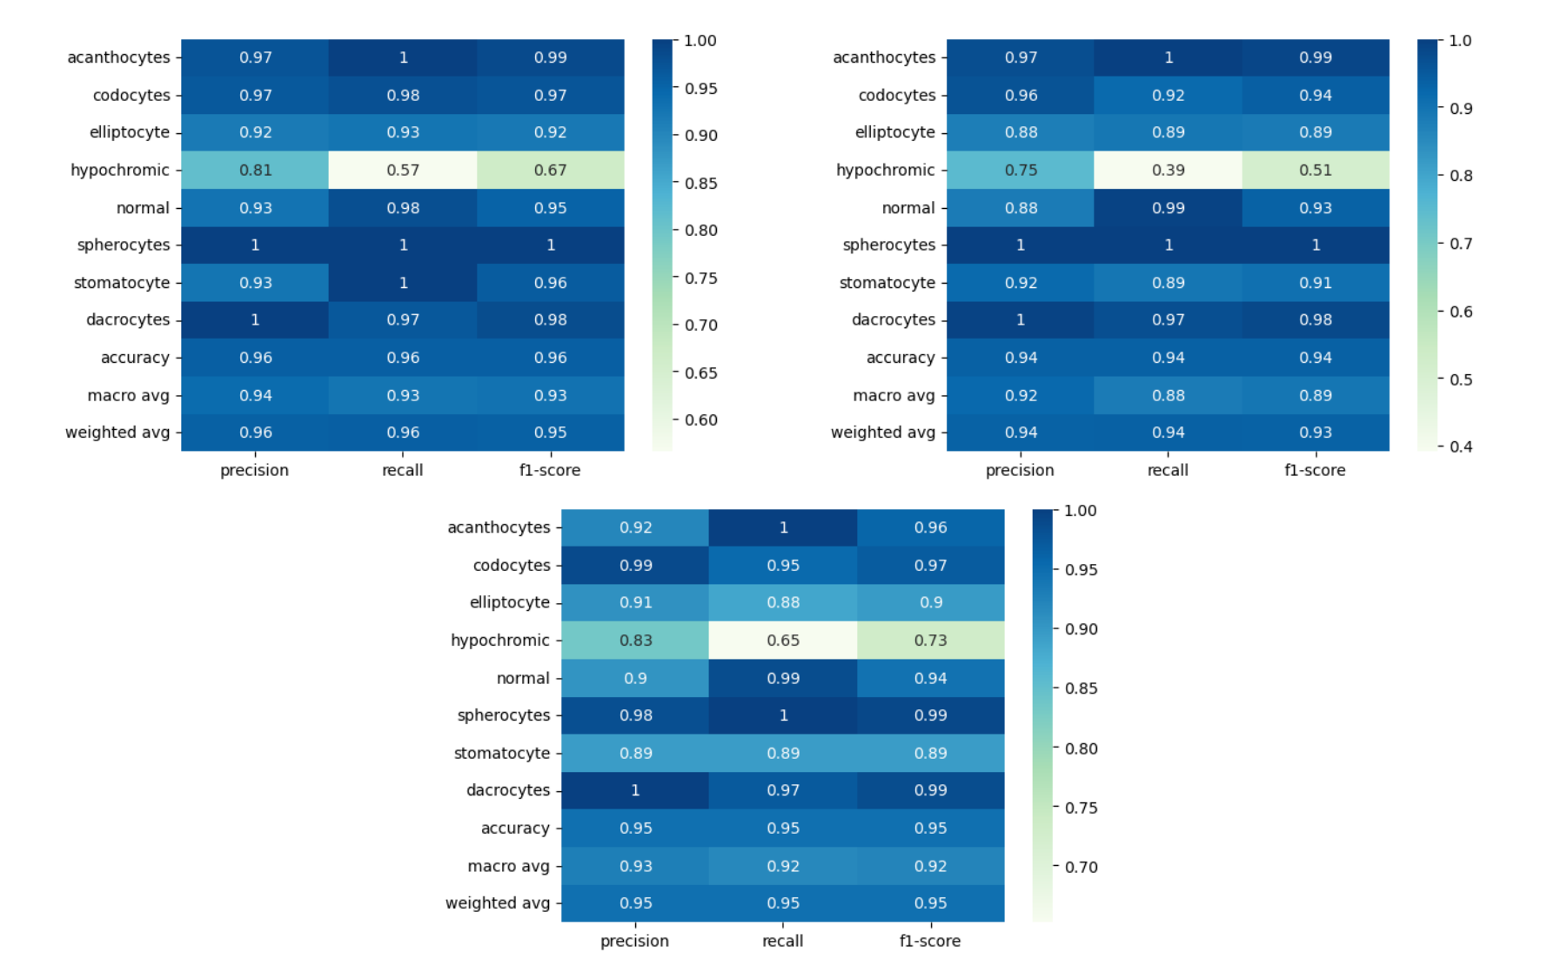
Results: DL Models

Slide 10
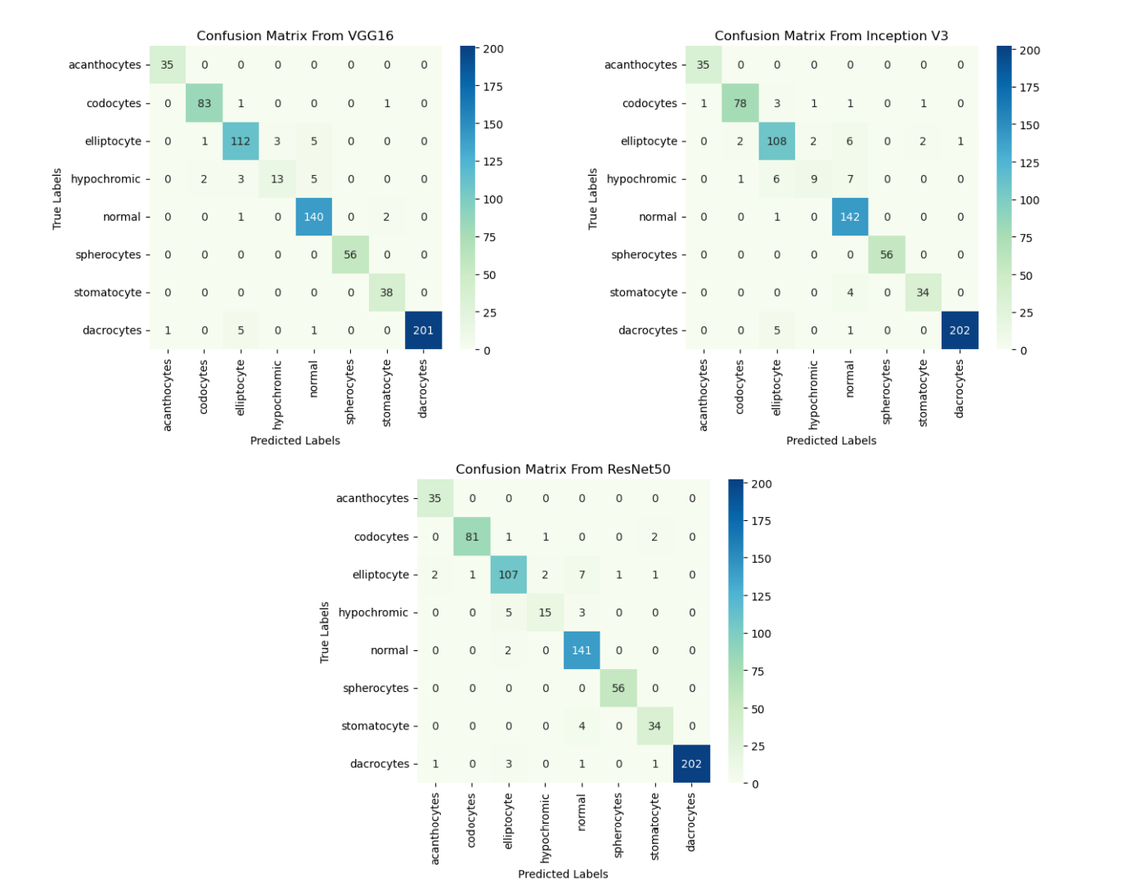
Results: DL Models

Slide 11
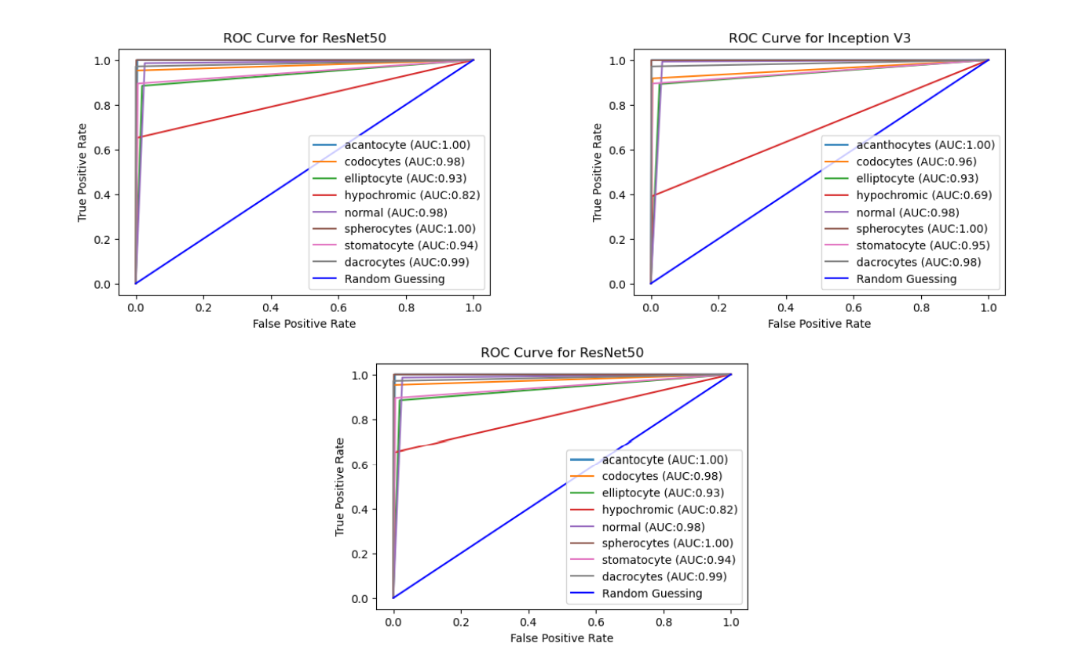
Results: DL Models

Slide 12
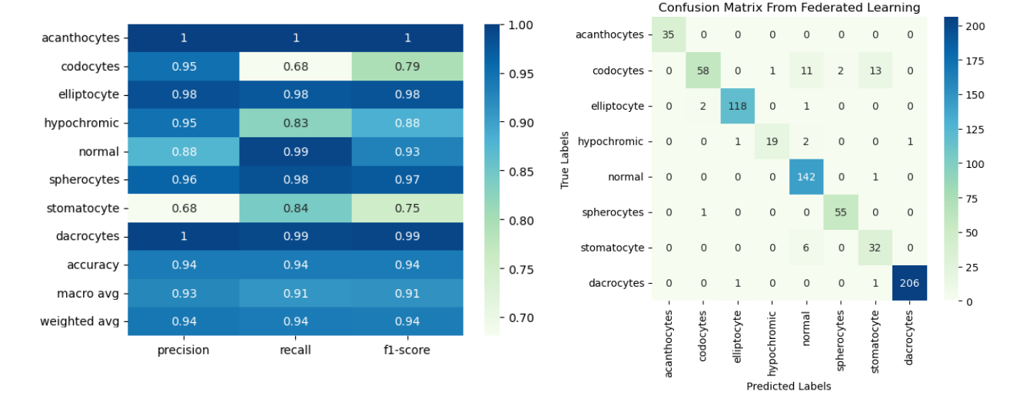
Results: Federated Learning

Slide 13
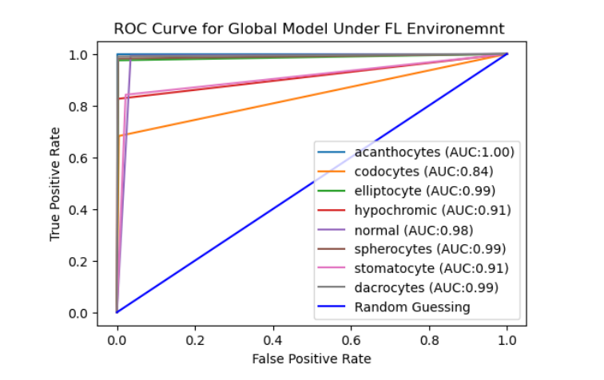
Results: Federated Learning

Slide 14
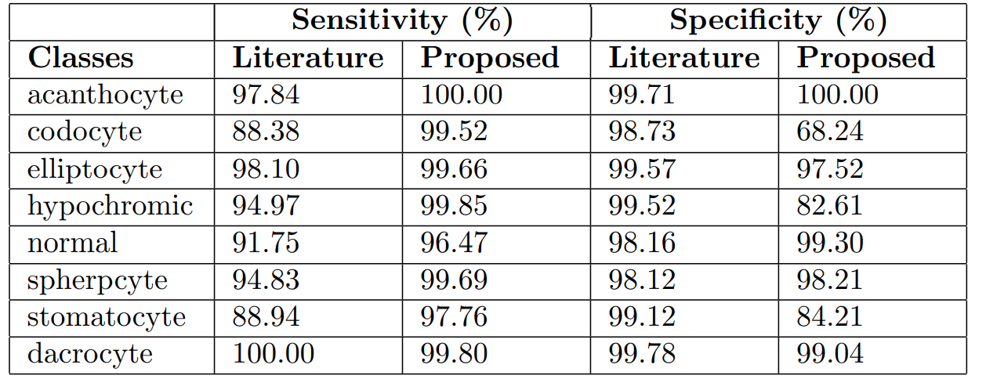
Results: Comparison Against Literature

Slide 15
Conclusion
This study denotes that the FL technique can protect the client’s data and detect RBC abnormalities from RBC images in contrast to the traditional deep learning approach while consistently maintaining the accuracy of the classification

